Slide 1

Using Strategic Foresight to See Past the AI Haze
Session 1: What’s Ripe for Disruption?
Joe Ballantyne & Don Abraham
Notes:
Don

Slide 2

Exploring Disruption
What are the 1-2 disruptions you’re currently planning for?
OR
What are 1-2 disruptions to your business from the past 10 years? (...can’t say COVID)
Please note your thoughts in the chat, or come off mute.
Notes:
Don

Slide 3
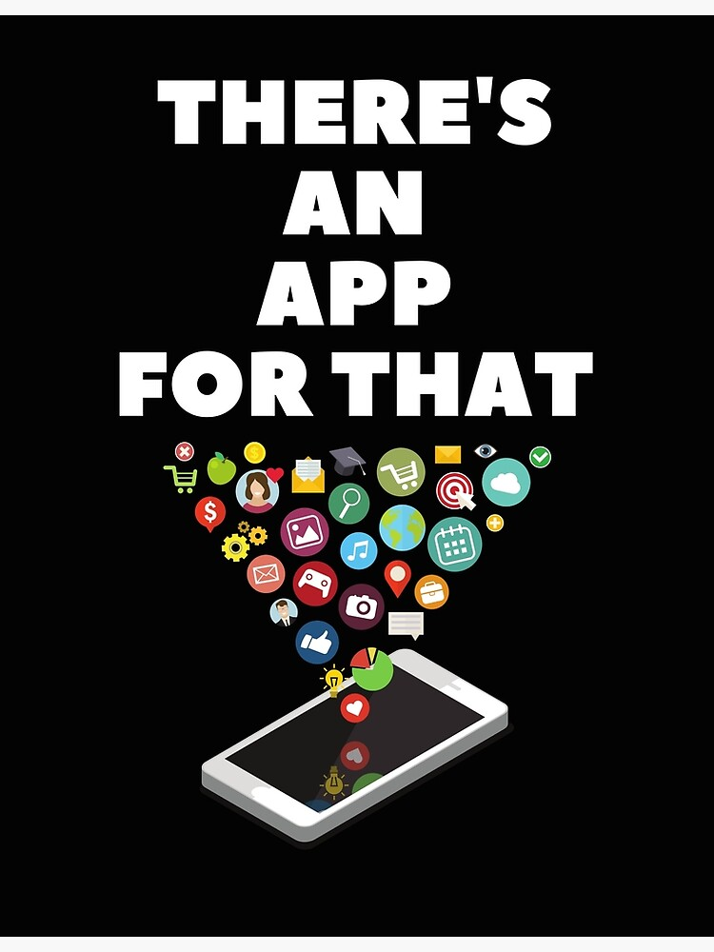
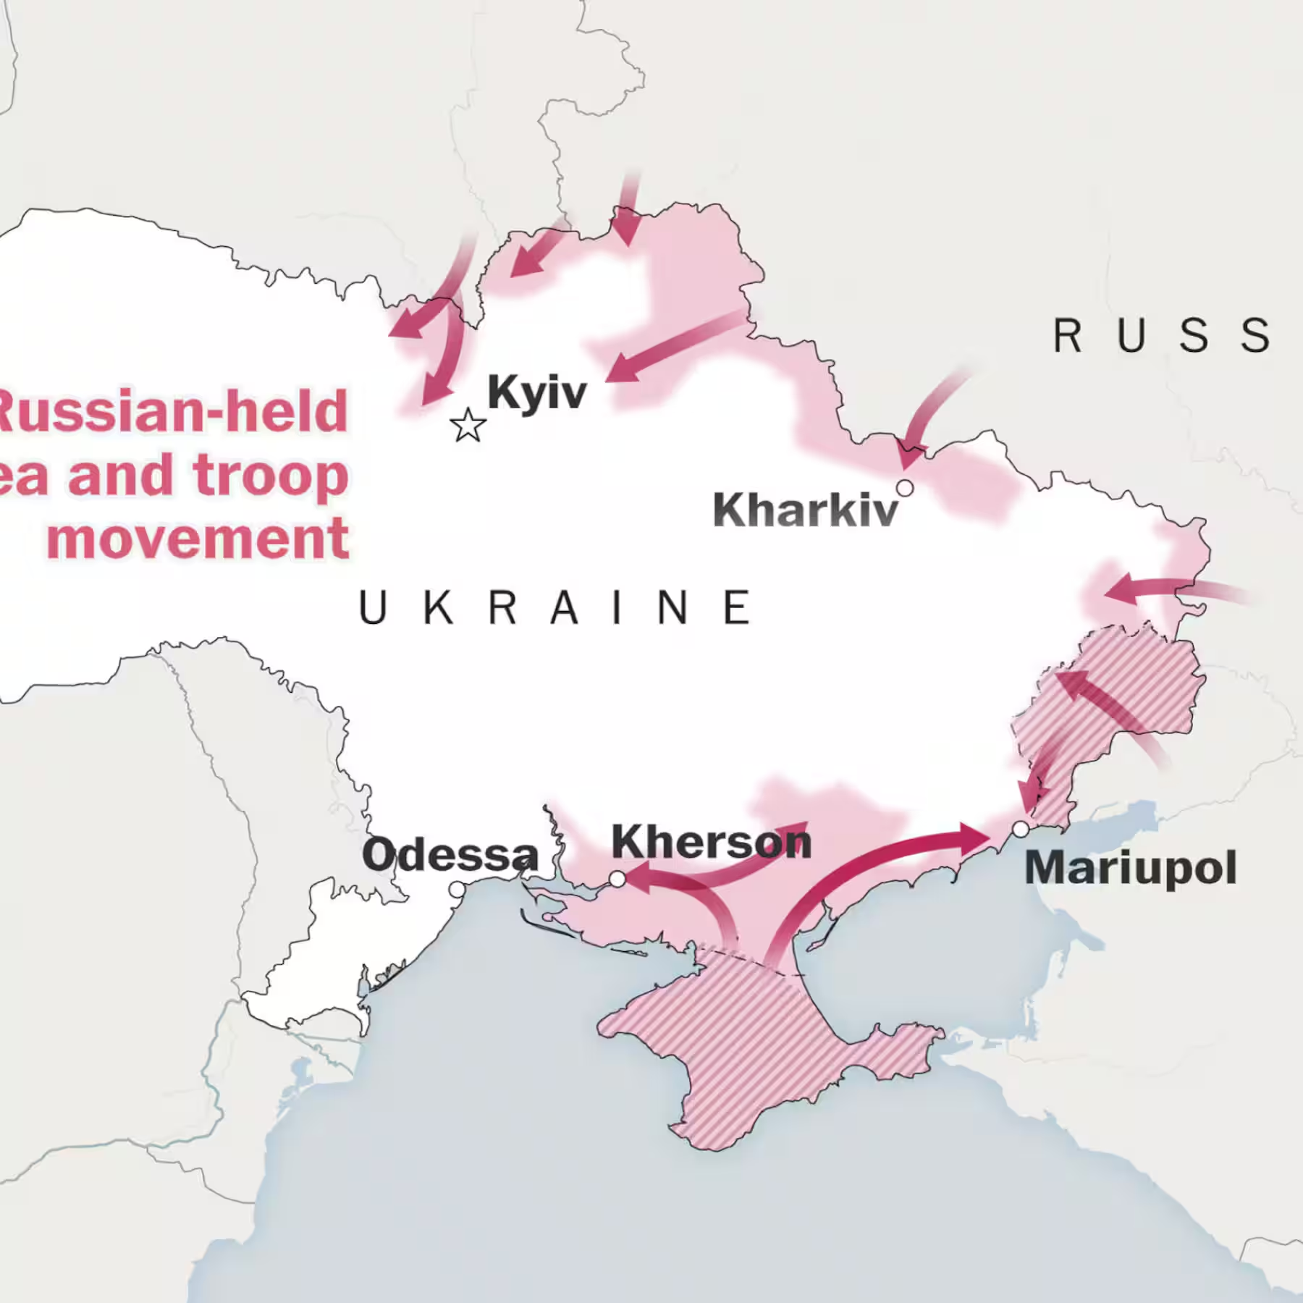
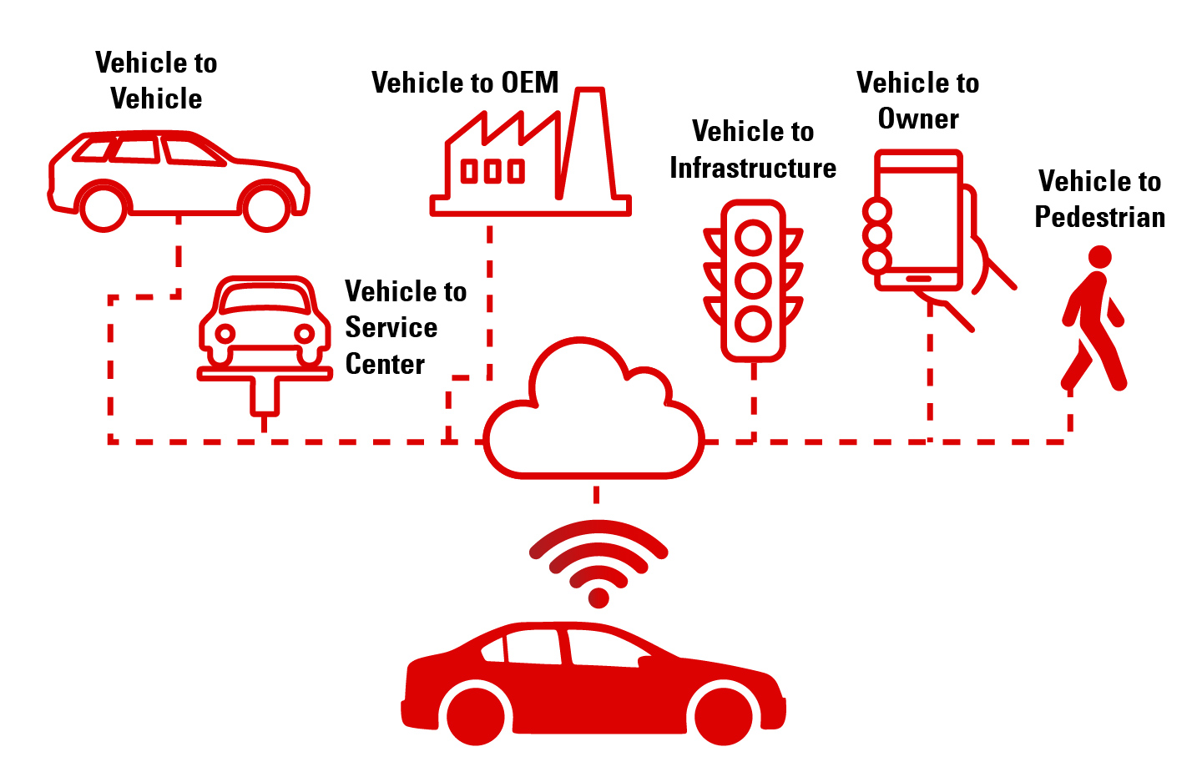
Disruptions rarely look and/or feel the same
Emergence of App Economy
Software Defined Vehicles
Invasion of Ukraine
Notes:
Don

Slide 4
Agenda
1
Introductions
2
Setting the stage with Future Agenda
3
Exploring disruption
4
6 dynamic spaces to monitor
5
Applying a disruption model
Notes:
Joe

Slide 5
Introducing Future Agenda
Our History: Founded in 2010, Future Agenda is the world's largest open foresight initiative, sharing Future Perspectives built from thousands of workshops with companies, academics and city leaders across 40+ countries.
Our Mission: Our aim is to connect the informed and the influential to help organisations identify emerging opportunities and make considered decisions.
Objective for Today: That you leave with more than "watch out for AI" — a usable way to spot the disruptions compounding underneath it, using a lens you can actually apply to your own planning cycle.
04
Notes:
Joe
Future Agenda is a the leading open-source foresight think tank and advisory firm — helping organisations understand emerging risks and opportunities so they can make more informed decisions and place better strategic bets, founded in 2010, since then we have collaborated with 100s of organisations, companies, governments and NGOs on better understanding the future.
Rather than working behind closed doors, it runs its research in the open: collaborative workshops and expert dialogues with senior voices across industry, government and academia, spanning cities and topics worldwide.
We conduct global projects on specific topics in depth. Undertaken in collaboration with leading organisations, these generate, informed perspectives of emerging opportunities - could be Patient Data (UCB), Sleep (IHG) Trade (UAE Ministry of Dif Economy), Digital Identity (Mastercard) and many others.
Our mission is to connect the informed and influential and to help ords to identify emerging opportunities and make better decisions.
Objective for today - not just ‘watch out for AI’, but a way to get better at spotting disruptions underneath, and to frame them back into your organisations in ways that make them respond

Slide 6


Your Presenters
Don Abraham
Joe Ballantyne
Director
Foresight, Innovation & Strategy
Director
Foresight and Strategy
Notes:
Joe / Don

Slide 7
Exploring Disruption
Why is it hard to plan for disruptions?
Please note your thoughts in the chat, or come off mute.
Notes:
Joe

Slide 8
Option B · Revised
From uncertainty to risk
Disruption becomes actionable only once it is quantified
Horizon scan
Scan the edges
Qualitative signals, outside-in (hint: it’s not STEEP)
Uncertainty
Not quantified: hard to act on
Critical uncertainties
Potential disruptions
Name the uncertainties
What could go either way? Bound the range
Quantified risks
In the
plan
Size the disruptions
Estimate how big, how fast and how soon
Score the risks
Probability and impact, including the off-radar ones
Put a number on it
Value and model it, so the business can absorb it
Risk
Quantified: ready to plan for
Notes:
Revised option B. Economists distinguish uncertainty, which cannot be measured, from risk, which can (Frank Knight, Risk, Uncertainty and Profit, 1921). Disruption work is the journey from one to the other. At the edge we have qualitative signals. Moving in, we name the critical uncertainties and bound them, size the potential disruptions, then score them as risks, including the off-radar ones. Only at the centre, once it has a number on it, can the business absorb it: into the plan, the budget, the risk register. The more quantified, the more applicable.

Slide 9
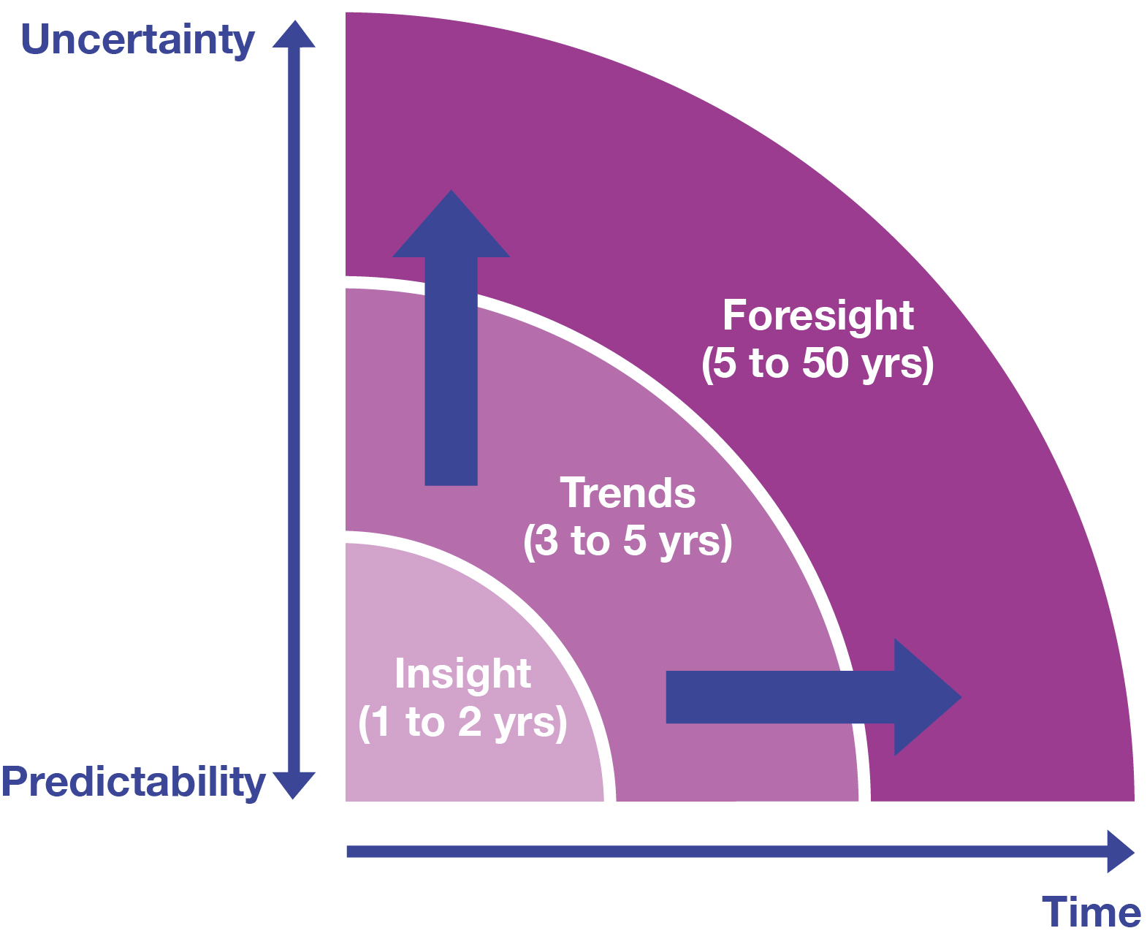
Disruptions and trends are distinct
It all begins with getting the time horizon and level of uncertainty your company is most comfortable with as an output
Disruptions are often missed because they are less likely to happen…but their potential impact is often catastrophic
Comfort with ambiguity is critical as is recognition that most change happens externally and outside our control
And yet - there are some fascinating certainties we should consider
Notes:
Don

Slide 10
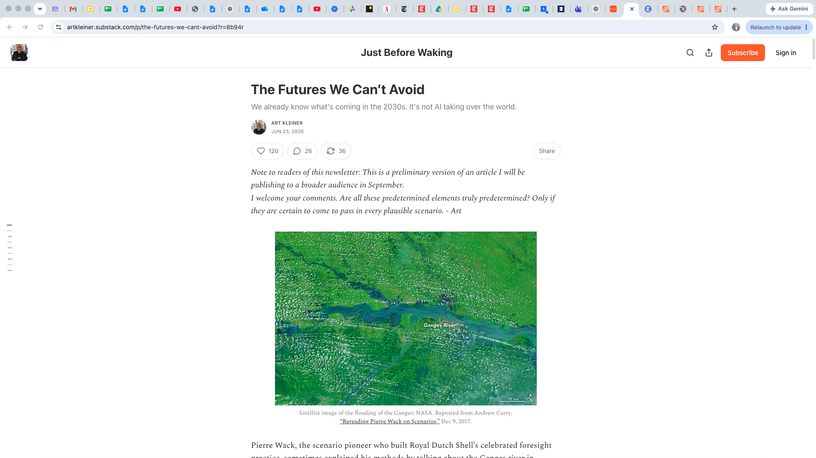









Let’s start with certainty
Climate crisis worsens
Water shortages intensify
Biological impoverishment continues
The 1.5°C threshold is already crossed (2024: 1.55°C) — extreme weather intensifies accordingly.
Fossil aquifers (Ogallala, N. China Plain, NW India) are depleting irreversibly.
7 of 9 planetary boundaries were already transgressed as of 2025.
Population balance shifts
Energy flips to renewables
Digital tech keeps maturing
Two-thirds of humanity now lives below replacement rate; by the mid-2030s, nearly all net workforce growth is African.
Solar and wind are poised to become the largest single source of global electricity.
A 75-year semiconductor trajectory is set to continue for at least another 10.
Medicine becomes personalized
The fiscal vise tightens
Human capability rises
Genome sequencing: ~$100M (2001) to a few hundred dollars today.
Debt and aging-population costs create structural pressure — the bonds are sold, the pensions are fixed.
The generation reaching adulthood by 2031 will be the most schooled in history.
Notes:
Joe
A lot of foresight work starts with uncertainty - that’s how scenarios are built, every consulting deck starts with VUCA.
But, when you look at it, there’s more certainty around than we often think, if we start to consider the predetermined elements in our world as the playing field. By understanding true certainties, we can leap ahead to framing our choices and modulating our expectations.
Art Kliner’s work - it’s great. Spirit of FA, we share great thinking with our community. Some of you may know him, written a lot of management, disruption, foresight. BRIAN MENTIONED 5 MINS BEFORE THE CALL THAT HE MIGHT JOIN
Opening — the Ganges metaphor: There's a story the scenario planner Pierre Wack used to tell about the Ganges. If there's heavy monsoon rain in the Himalayan headwaters, you can say with total confidence that there'll be a flood five days later, 650 miles downstream at Allahabad.The people in Allahabad don't know the flood is coming. But Wack did — because he'd already seen the rain fall. As he put it: "This is not fortune-telling. This is merely describing the future implications of something that has already happened."
That's the spirit of this slide. Everything on it has already happened, upstream. The carbon's already in the air. The children who'll be in the 2031 workforce are already born. The debt is already sold. We're just describing where the water goes next.
Climate and resources: Take the climate line. The interesting number isn't really 1.5 degrees — it's that insured losses from weather disasters have been compounding at 5–7% a year, in real terms, for three decades. That's not really about the weather getting worse — it's that we keep building expensive property in its way.
Water is a similar story - The aquifers draining under the Middle East, North Africa, South Asia and the American Southwest are fossil aquifers — they don't recharge on human timescales. So this isn't a bad-rainfall-year problem, it’s more of a savings account we’re withdrawing from.
People: Two-thirds of humanity now lives below replacement rate. As of 2026, humanity is likely below replacement fertility. That has never happened before, not in wars or pandemics. And this compounds - fewer people born means fewer people in future to have babies.
And the reason it won't reverse isn't really about incentives or policy — researchers tracing this back find it's tied to the erosion of patriarchal kinship structures, over centuries. Wherever women gain autonomy, they defer childbirth. So the "pay people to have more babies" instinct is arguing with a few hundred years of momentum.
Energy and technology: On energy — renewables overtake coal as the single largest source of global electricity by the end of this year. But don't let anyone leave this slide thinking that means cheaper power. Demand keeps rising to absorb the new supply — AI compute, desalination, cooling — so the grid gets greener, not necessarily cheaper.
Medicine and money: Medicine has a similarly steep curve — sequencing a genome went from $100 million to a few hundred dollars, faster than Moore's Law. Personalised oncology goes mainstream by around 2031. Probably not in time for people in their seventies and eighties today — but well in time for most people currently in their forties.
And on the fiscal side, the debt itself is genuinely certain — it's sold, the pensions are fixed. What isn't certain is whether that becomes a crisis or just a long chronic condition, and that hinges on interest rates.
And to end where it's worth ending — despite all the noise about test scores and AI doing our thinking for us, the generation reaching adulthood by 2031 will be the most educated in human history. It's a good place to pause before we move from certainty into what's genuinely uncertain.

Slide 11






…and six lenses on uncertainty
Health
Wealth
Happiness
Mobility
Security
Locality
07
Notes:
Joe
So that's the certain part — the ground that's already moving under everyone, whether you plan for it or not. What's far less settled is how those forces actually land on a business, and that's where these six lenses come in the second half of the model Don and I alluded to. For those, we are considering the six
These six aren't new — they're the original clustering from Future Agenda's first programme, The World in 2020, where forty-eight probable futures from workshops in over twenty countries all sorted into these same six buckets. They stuck because together they cover the ground: physical wellbeing, economic condition, social state, how people and things move, what keeps us safe, and where we are. That's why we're using them again as the hunting ground for uncertainty here.
Worth saying that these don’t include AI bucket. Don’t work as STEEP. Tech, politics, etc - those things all cut across this list - find this a richer way to consider uncertainty.

Slide 12
Exploring Disruption
What would need to happen for this disruption to emerge?
What risk would come out the other side?
Please note your thoughts in the chat, or come off mute.
Notes:
Don

Slide 13
Health
TWO DISRUPTIONS FOR 2035
Theme 1 of 6
Life expectancy for the top 1% reaches 100 by 2035, driven by personal health tech — opening a 20-year gap between who can buy more years and who can't.
2030 WORK, IN BRIEF
Traced health moving from treatment toward prevention, patient-owned data and hospitals rebuilt for early intervention — plus new disease risk from a warmer, more connected world.
By 2035, biological age, not chronological age, will be a standard line item in hiring and insurance underwriting.
Notes:
Don

Slide 14
Wealth
TWO DISRUPTIONS FOR 2035
Theme 2 of 6
By 2035, Federal court systems will take a back seat to the World Trade Organization as a result of the current surge in nation-states directly investing in global corporations.
2030 WORK, IN BRIEF
Explored how work, talent and organisational structures are being reshaped by more open, flexible employment models, alongside early levies on data and emerging economic assets.
The four-day work week becomes statutory across a critical mass of OECD economies by 2035.
Notes:
Don

Slide 15
Happiness
TWO DISRUPTIONS FOR 2035
Theme 3 of 6
Employee disconnection and misery become a recognized workplace liability by 2035 — insurable, litigated and audited the same way harassment and fraud are today.
2030 WORK, IN BRIEF
We touched open organisational models, wellbeing, and philanthropy.
Wellbeing-adjusted growth could sit alongside market cap by 2035 as something reported, audited, and something you don’t yet track. OR Intergenerational skill exchange becomes a government-incentivized workplace policy by 2035.
Notes:
Don

Slide 16
Mobility
TWO DISRUPTIONS FOR 2035
Theme 4 of 6
Low-altitude airspace above facilities and cities becomes a contested, regulated resource — much like built infrastructure is today.
2030 WORK, IN BRIEF
Looked at the physical movement of people, goods and resources — electric aviation, autonomous vehicles, and water systems under growing strain.
By 2035, resiliency corridors immune to extreme weather events emerge in formerly undesirable parts of the globe, shifting global trade and migration flows.
Notes:
Joe

Slide 17
Security
TWO DISRUPTIONS FOR 2035
Theme 5 of 6
By 2035, knowing which internet you operate on could be as basic a strategic question as knowing which currency you’re priced in.
2030 WORK, IN BRIEF
Tracked a shift toward digital identity and data provenance, eroding privacy as health data merges with surveillance, and rising influence of unaccountable organisations.
The ongoing battle for data security/treaties replaces military wargaming/alliances as the defining national security investments for most developed countries.
Notes:
Joe

Slide 18
Locality
TWO DISRUPTIONS FOR 2035
Theme 6 of 6
Reshoring has already gone mainstream — the sharper edge is regionalization within countries, fracturing a single national strategy into dozens of local playbooks.
2030 WORK, IN BRIEF
Growing regional divergence — soil degradation, climate restoration, and shifting global positions — local context now outweighs global uniformity.
Soil restoration becomes a tradeable national asset class by 2035, turning degraded land from liability into climate investment.
Notes:
Joe

Slide 19
Exploring Disruption
Initial reactions
What don’t you see here that you expect to be a source of disruption?
Please note your thoughts in the chat, or come off mute.
Notes:
Don / Joe

Slide 20
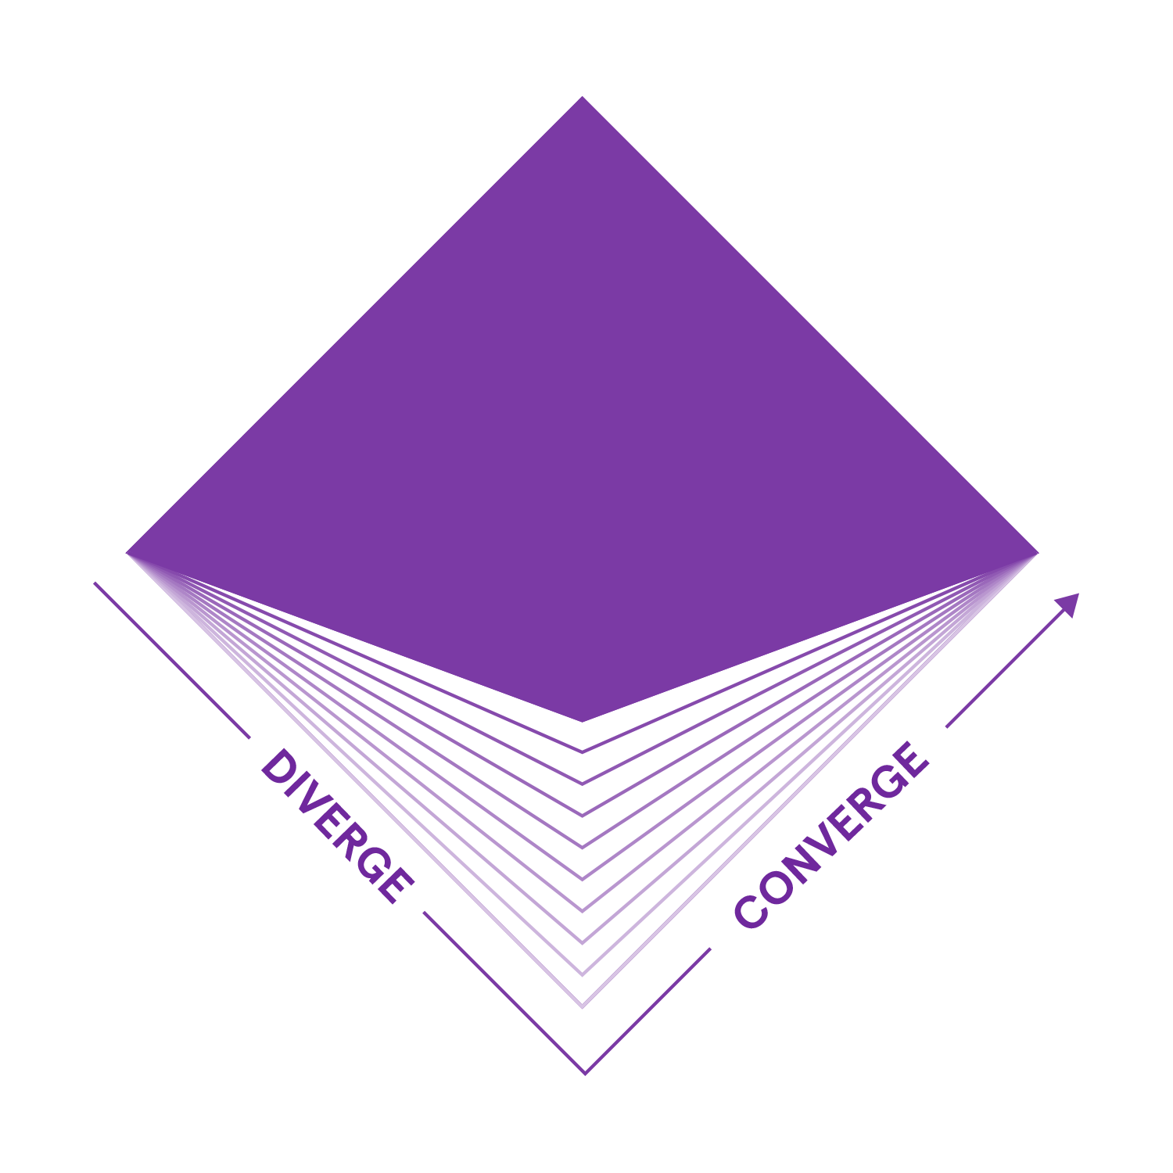
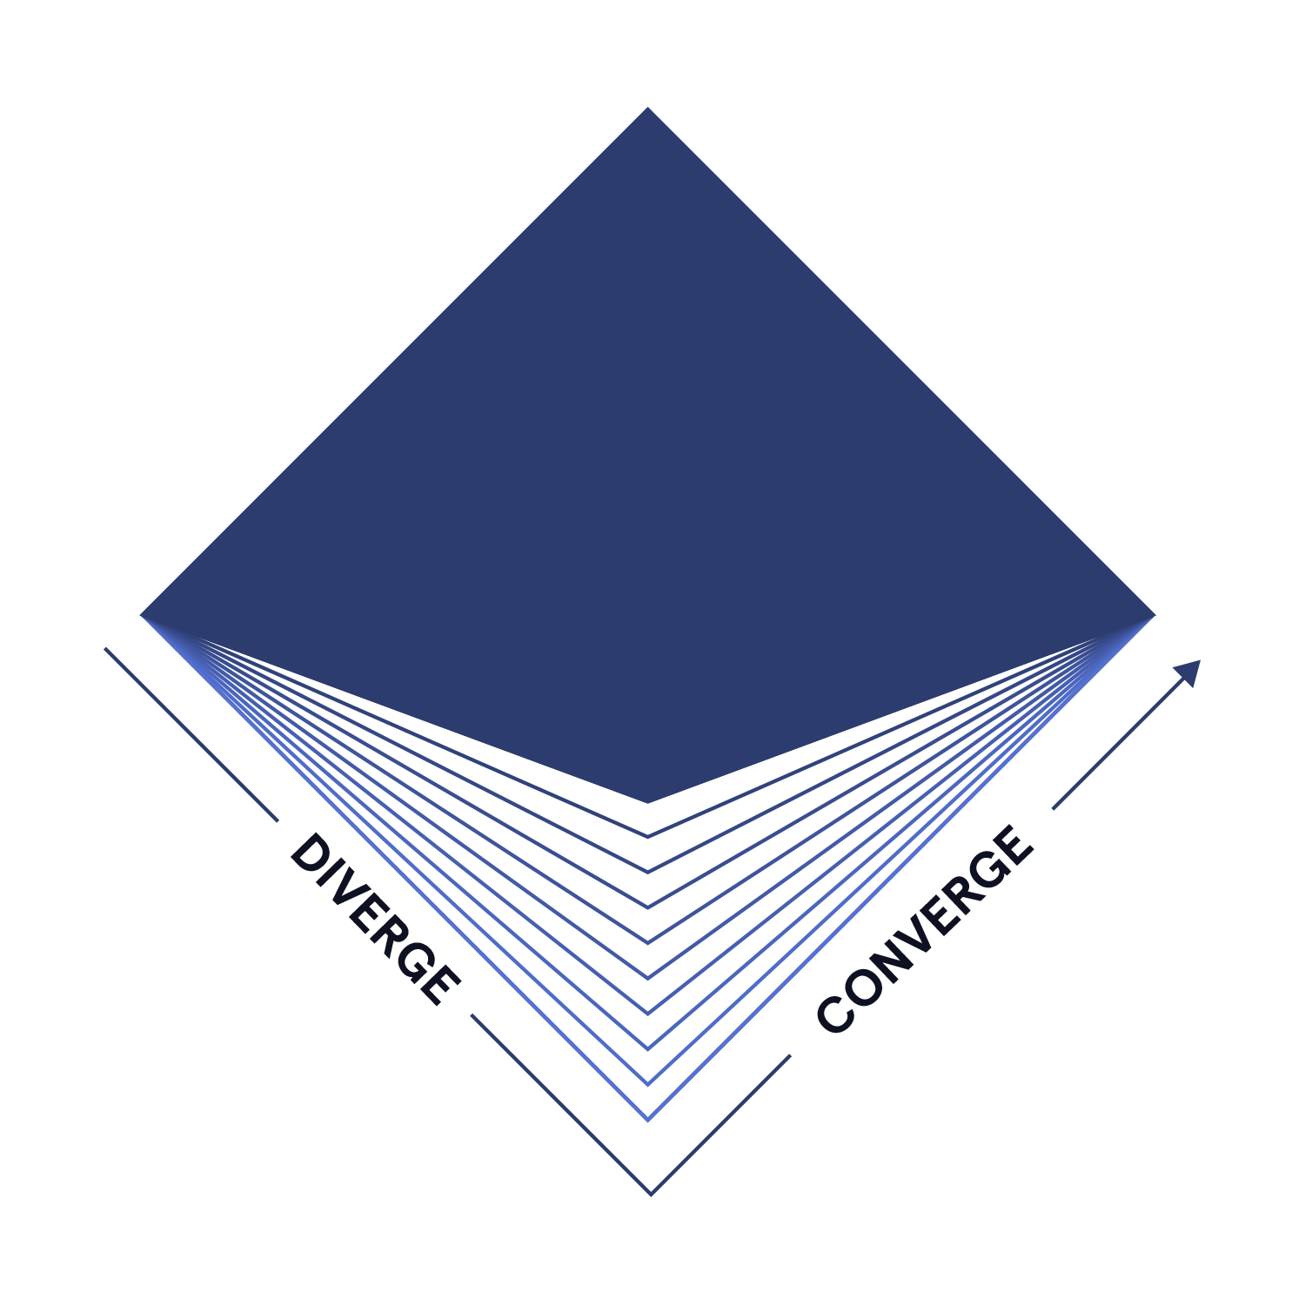
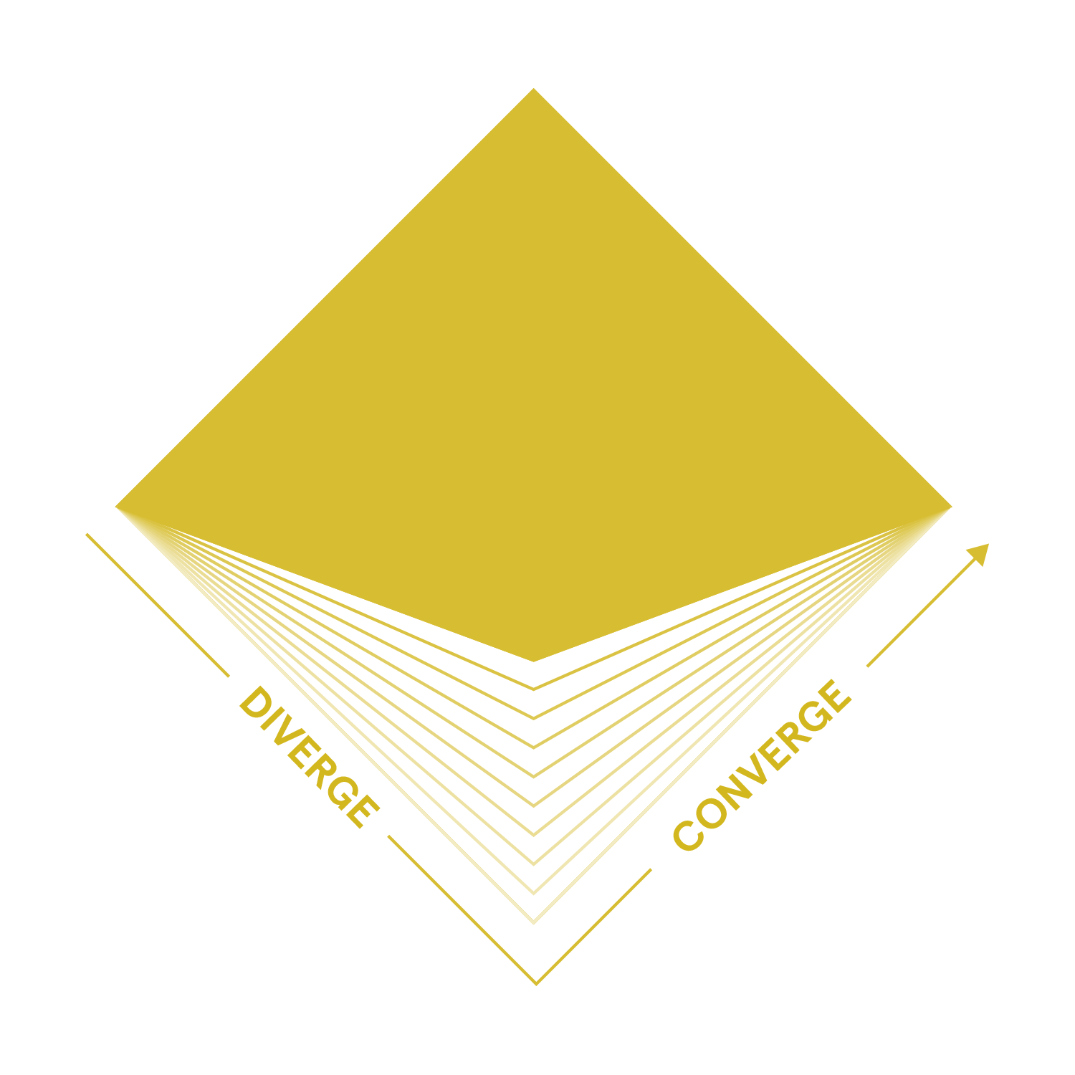
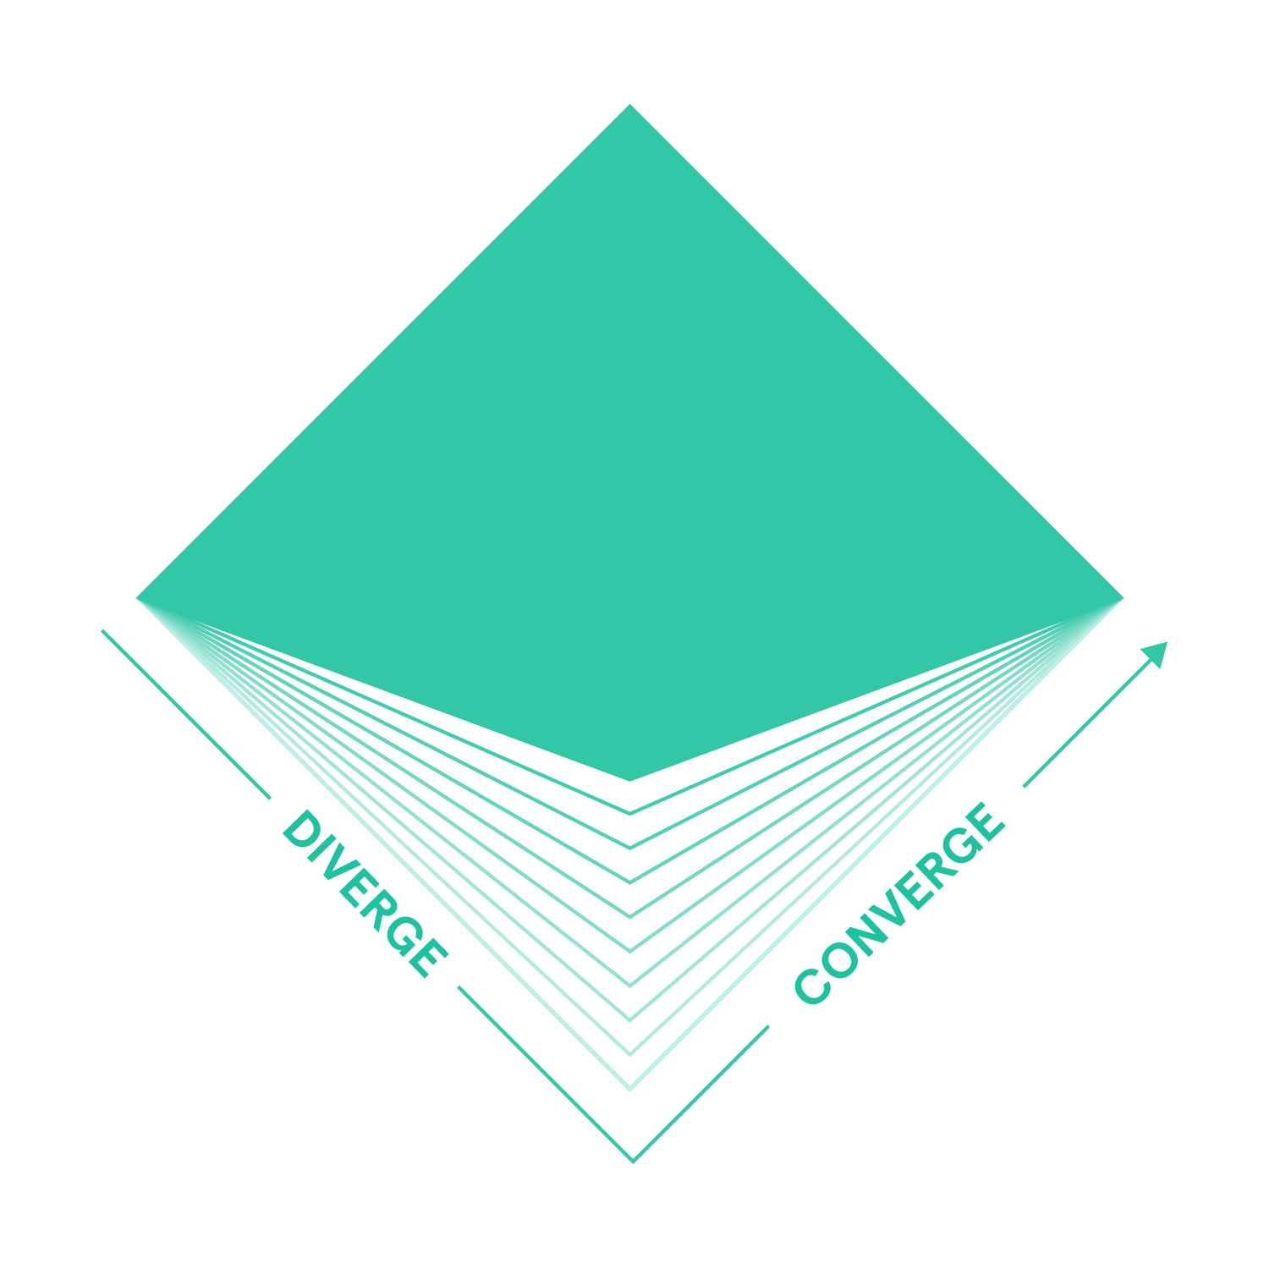
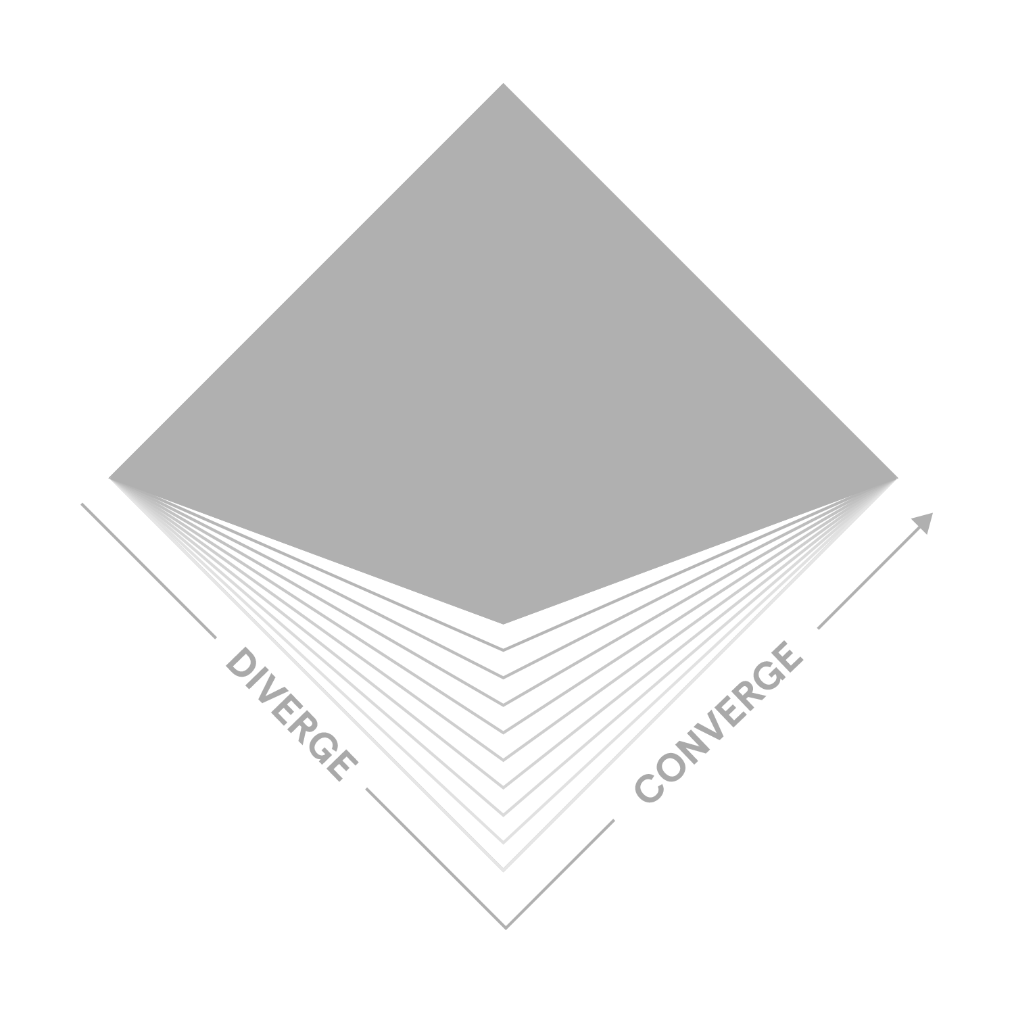




A reminder of where disruptions sit
Internal & External
Horizon Scan
Critical
Uncertainties
Potential Disruptions
Off Radar Risks
Business Implications
Outside-In exploration of the critical domains to your business
(Hint: It’s not STEEP)
Understand the uncertainties shaping the marketplace using an outside-in approach
Anticipate accelerating disruptions over the next decade
Catalogue medium probability/high impact risks and build a risk radar
Assess, model and socialize the actionable implications for the business
Notes:
Don

Slide 21
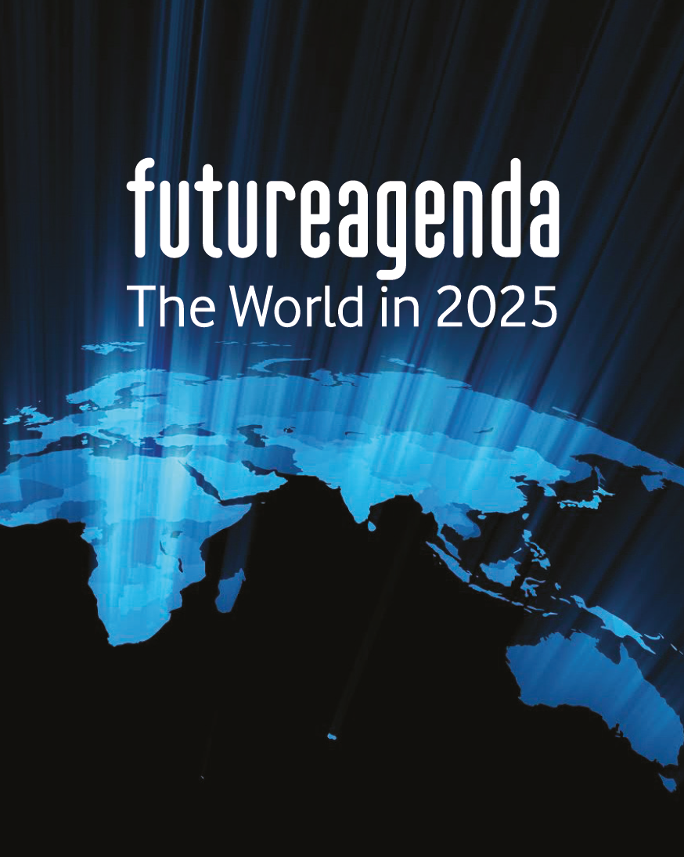
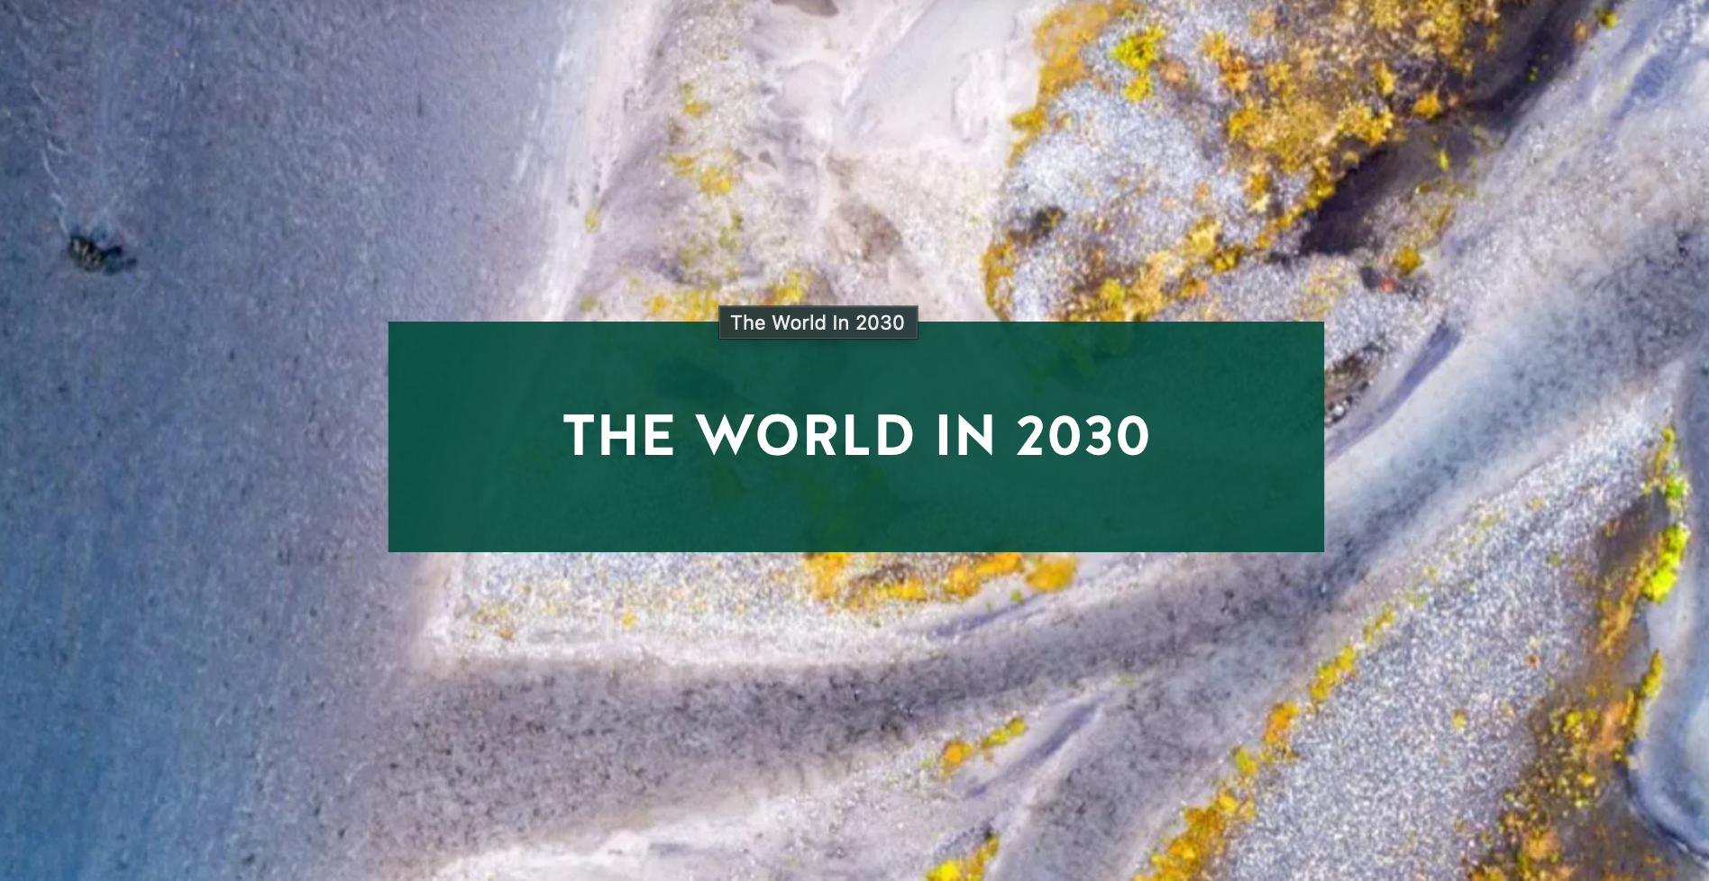
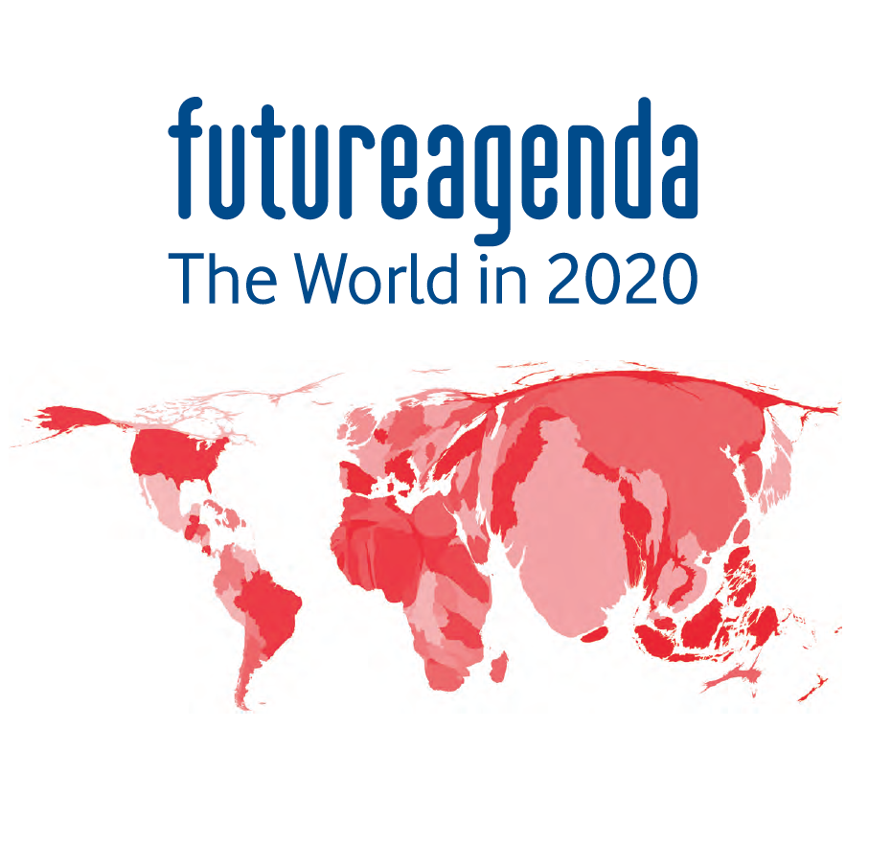
We are now framing the World in 2035
What are the future dynamics that every CEO needs on their future agenda?
Who are the thought leaders we should talk to as we shape our POV?
What should we consider as we go from your perspective?
And what should we say about Artificial Intelligence…
Notes:
Don

Slide 22
Seeing Past the AI Haze
Tune in next time!
The AI Blind Spot(s)
We will tackle a few key areas around and through the haze.
And we promise it will be a fun and actionable discussion (again)!
September 17, 2026
Notes:
Don / Joe - ask them what they want us to address here.

Slide 23
Thank you!
don.abraham@futureagenda.org
joe.ballantyne@futureagenda.org

